Slide 1


Slide 2

High frequency bands for more Gigabit & farther range
Kyriakos Vergos
Chief Commercial Officer
kvergos@intracom-telecom.com

Slide 3
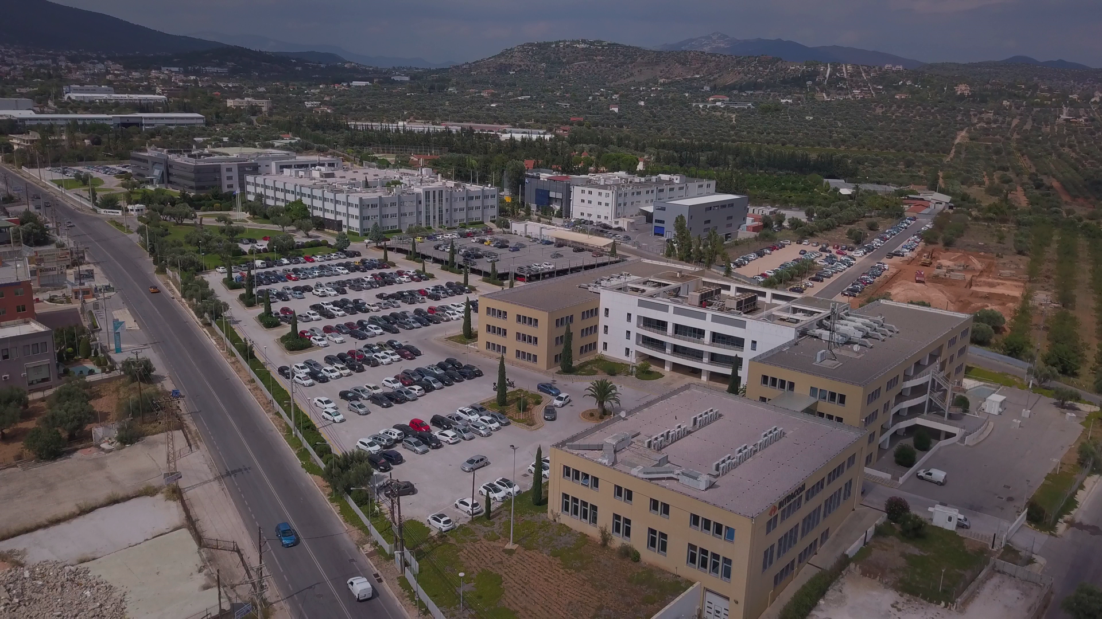

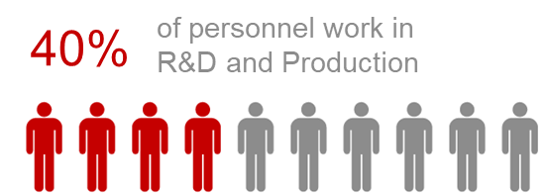
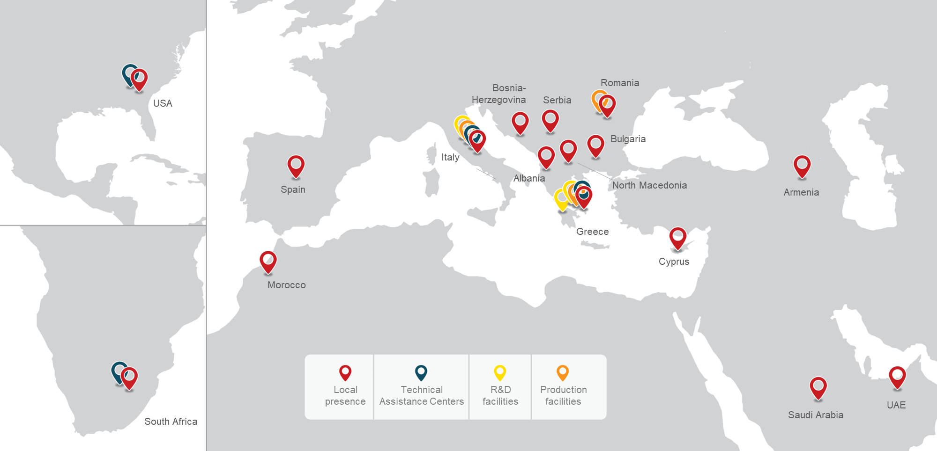
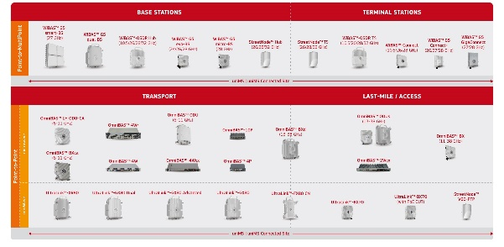
International presence
Strong R&D and Innovation
Leading Wireless Transport & Access products

Slide 4
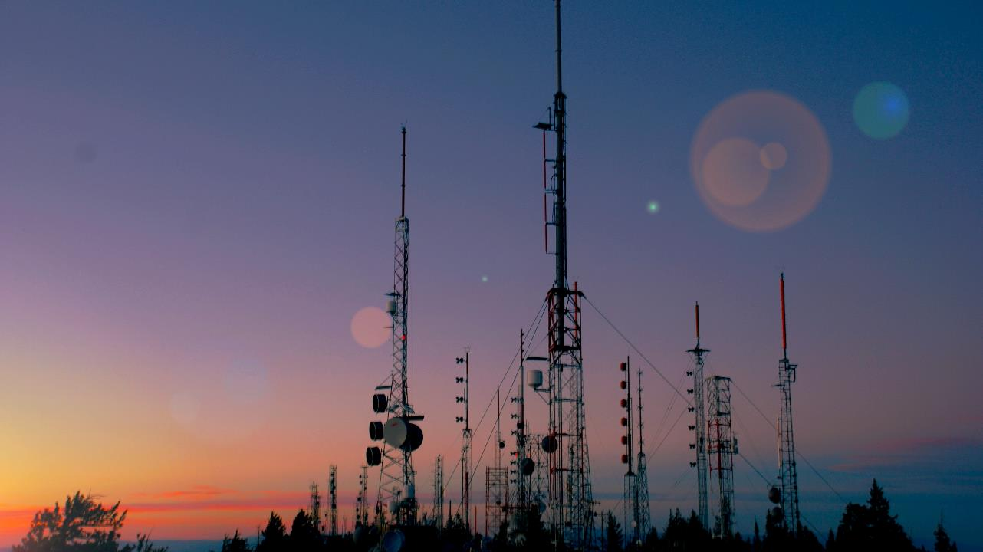

We are in the network infrastructures business for more than 40 years
We control 100% of
    product development
    supply logistics
    product manufacturing
    Product support
We continuously invest in technology innovation and product evolution
We have been developing FWA products since late 90’s
We develop wireless transport technology for more than 20 years
Company
Overview

Slide 5






Diverse variety of industries served

Slide 6
Technology evolution transforming and growing business
Regulation & Funding
(authorities)
Technology
(vendors)
Business plan
(operators)

Slide 7
High-band spectrum for Reliable Broadband Service
Bands of licensed frequencies are the new foundation for Reliable Broadband Service
  Predictable performance
  Free from interference
High bands specifically have an abundance of spectrum
  Channel sizes wide as much as 400MHz for FWA
  Channel sizes up to 2000MHz for Middle mile transport
High bands fit for ultra broadband service and middle mile deployment
  FWA
    LMDS bands (29.10 to 29.25 GHz and 31.00 to 31.30 GHz)
    UMFUS bands (24 GHz, 28 GHz, 37 GHz, 39 GHz, and 47 GHz)
  Middle mile
    E-Band (71-86 GHz)

Slide 8
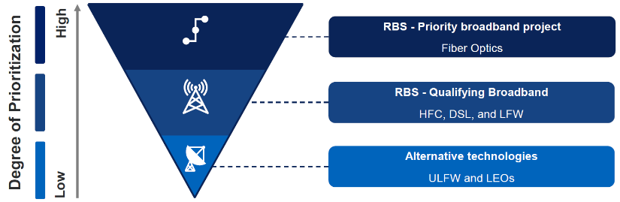

Broadband Equity, Access, & Deployment (BEAD) Program
$42.5bn boost for broadband connectivity.
“biggest investment ever” in high-speed internet, with the goal of connecting all Americans by 2030.
Funds allocated to 50 states to roll out broadband to unserved and underserved regions.
24 million households in the USA do not have access to high-speed internet access.
Reliable broadband service (RBS) technologies
  Fiber-optic
  Cable modem/hybrid fiber-coaxial (HFC)
  Digital Subscriber Line (DSL)
  Terrestrial fixed wireless utilizing entirely licensed spectrum or using a hybrid of licensed and unlicensed spectrum
Licensed FWA
Unlicensed FWA & Low Earth Orbit Satellites
National Telecommunications & Information Administration

Slide 9

Enabling technologies at high bands for more gigabits & miles
Smart antenna
Active antenna
Auto correction
Spectrum efficiency
Channel reuse
Carrier loading
Smart software
QoS
Automations
More Gigabit
Farther range

Slide 10
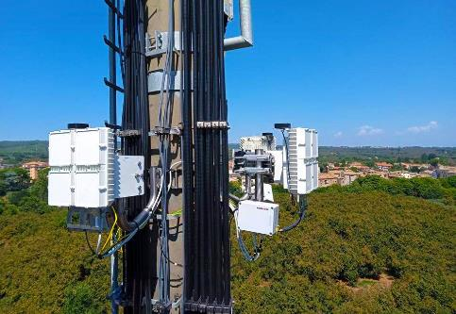
Extending, speeding up, and densifying FWA with Active Antenna System
Multiple antenna arrays per sector radio
Multiplying transmit/receive paths
  Enabling channel reuse
  Facilitating higher order channel reuse
  Hybrid Beamforming
  Enabling cleaner channel of operation
  Concurrent use of V & H polarization
  Achieving farther range of connection
  Multiply channel capacity by 2 or 4 or more times
  Accommodate more than 500 subscribers in sector area
Reach subscribers farther than 5 miles

Slide 11
High Band channels boosting the capacity of FWA networks
High bands have plenty of bandwidth
  Wide channels 200MHz or wider can be used
Use of MIMO techniques to reuse channel
  Use the same channel 4 or more times on sector radio
  Use the same channel 2 or more times on terminal radio
Multi carrier
  Use more than 1 carrier per sector
Capacity per sector 5.6Gbps, per cell 22.4Gbps
Occupied bandwidth 400 up to 800MHz
Enough capacity for CIR service, and for high PIR
2 Gigabit/s speed of subscriber connection

Slide 12
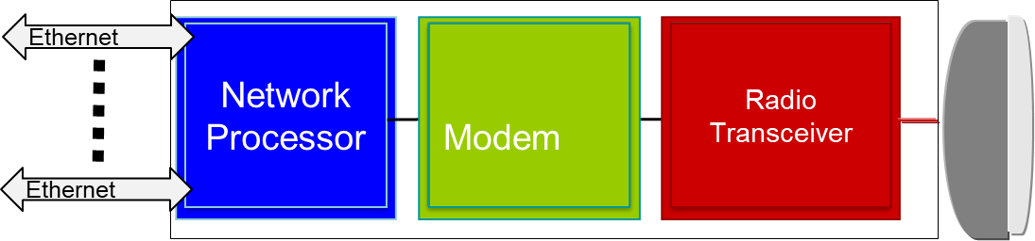
Making E-Band transmission more effective & more reliable
High carrier loading
  15Gbps on 2000MHz, 10Gbps on 1500MHz)
High modulations
  Up to 1024QAM
High system gain
  More than 70dB @128QAM, 2000MHz
Extended range for standalone E-Band
Capacity gains for Multi Band Link configuration
High service and link availability

Slide 13
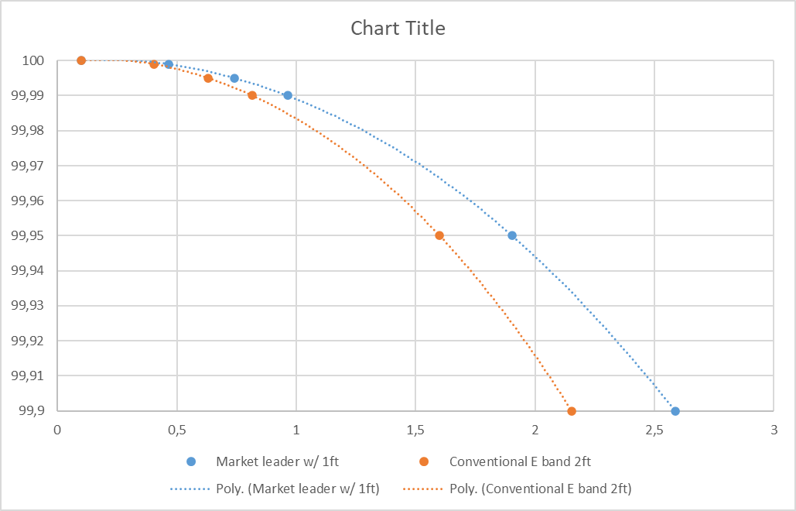
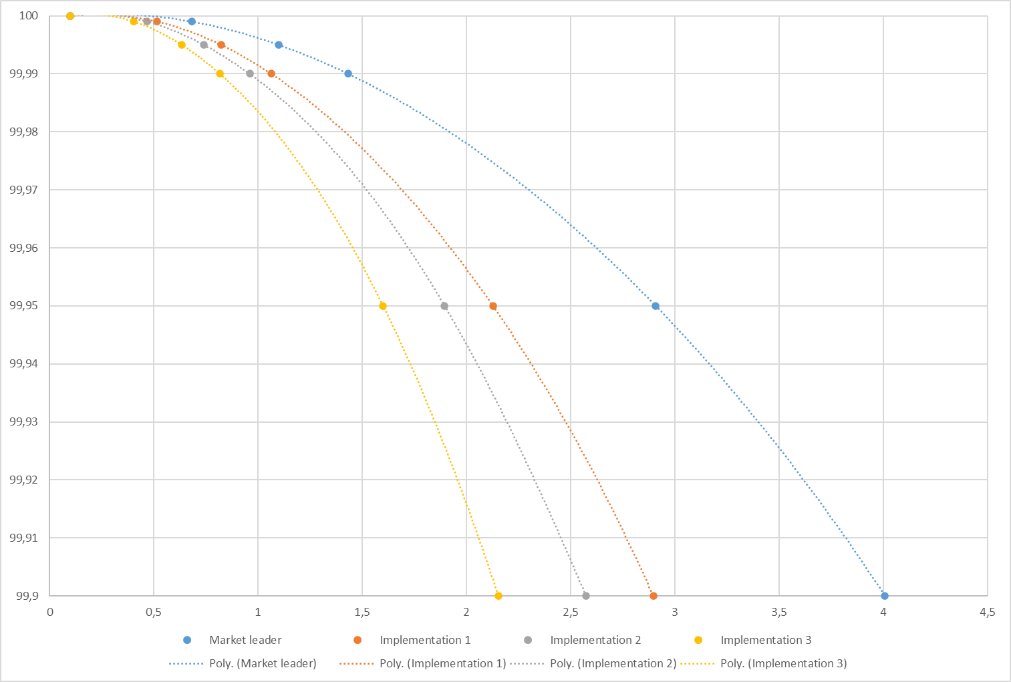
Gains from technology innovations at E-Band
Size of antenna can be reduced Go farther range

Slide 14
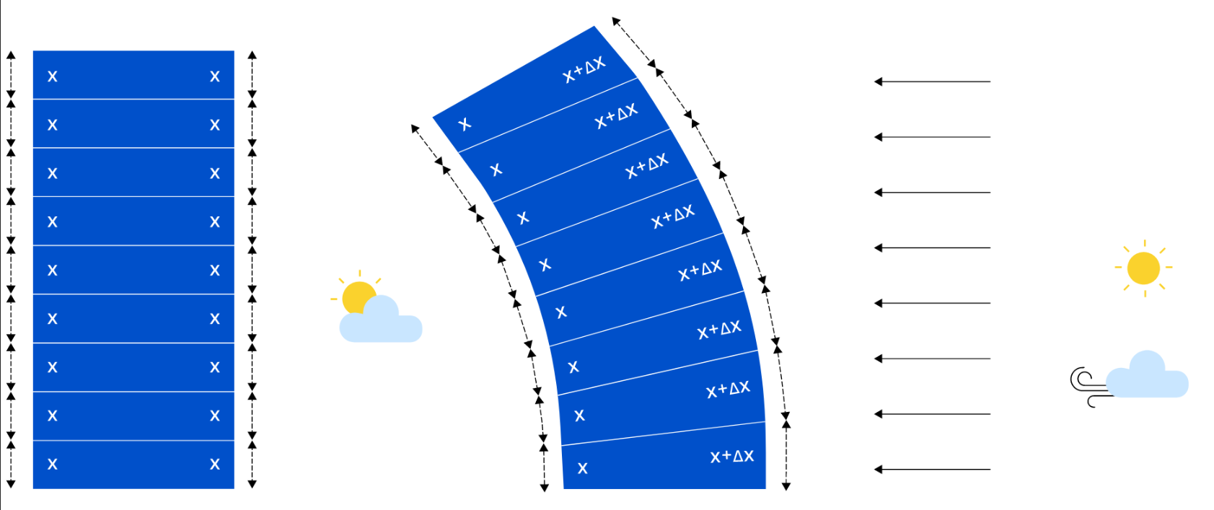
E-Band antenna beam correction
Why Beam tracking antenna is needed at 80GHz
  Differential Sun heating of support structures causes warping of poles/towers
  Wind may induce vibrations/swaying
  Esp. important for lower quality infrastructure (monopoles, lattice) & 60cm or larger antenna diameters
  E-Band antennas have very narrow beamwidth (1-0.5deg) & the link alignment is affected by this effects
  As a result, operational modulation formats are downgraded. In extreme cases link may be interrupted

Slide 15
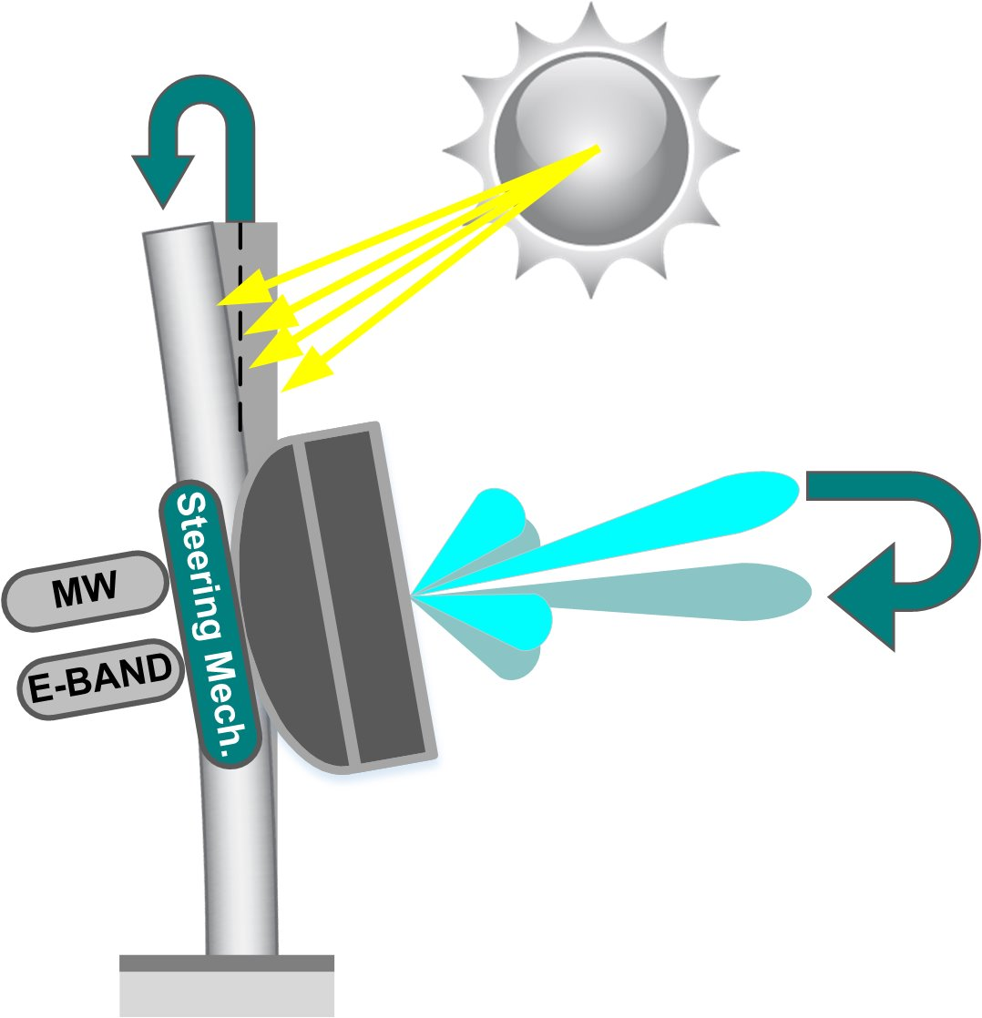
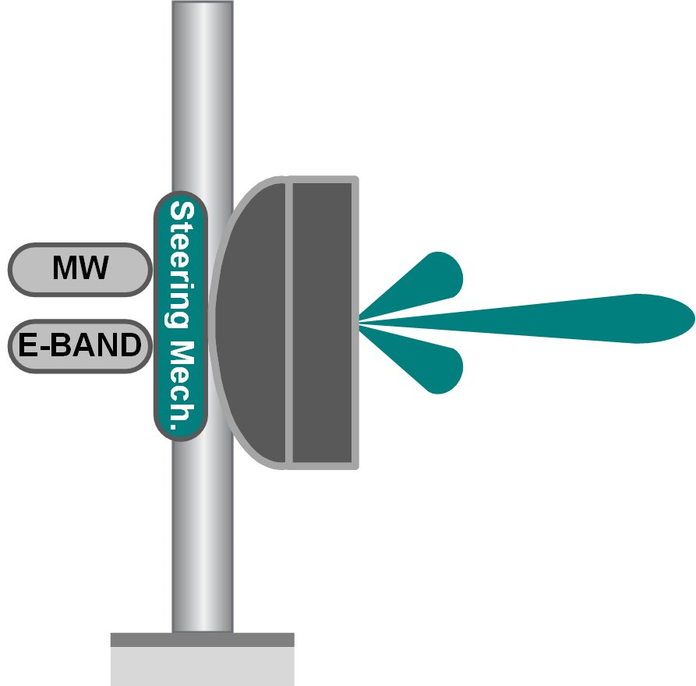
Beam Tracking Antennas at 80GHz
Beam tracking antenna - Compensates for installation infrastructure warping/tilting effects
  Allows installation of large(r) diameter antennas on low quality poles
  Antenna automatically steers beam to compensate for pole tilting deformation of +/-1.5degrees (in 1-D or 2-D)
  Allows more widespread introduction of 90cm antenna (0.3deg beamwidth) → ~ +6dB system gain per link

Slide 16
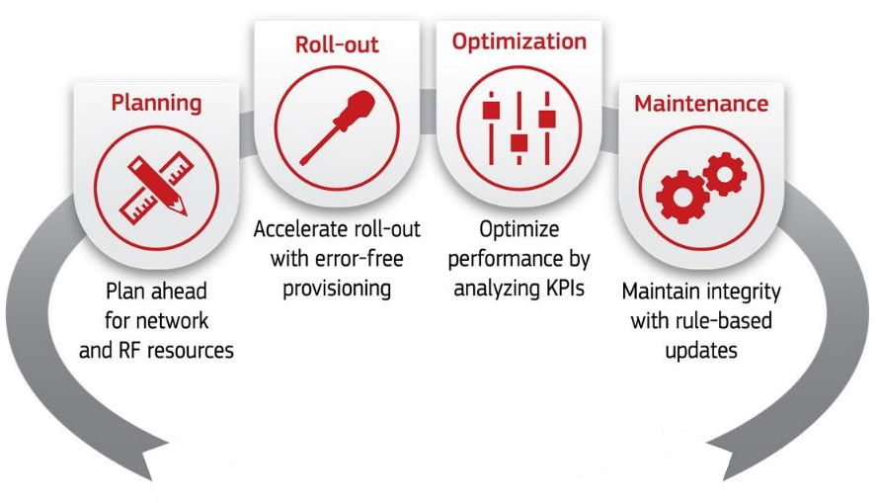
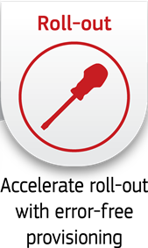
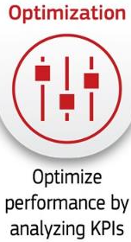
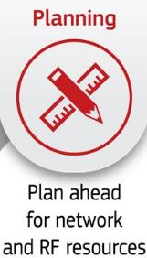


Smart software for automations and management
Rollout
  Streamlined and error-free (Zero-Touch) service provisioning
Optimization
  Sophisticated faults correlation and reporting for precise interventions
Planning
Smart algorithms & closed-loop comparison between planned and actual data
Maintenance
Minimizing shortage of
operational quality
  A Network Lifecycle platform, closing the loop between lifecycle phases, simplifying the synergy between users
  (Radio Planners, NOC Personnel and Field engineers) and improving collaboration among decision-makers.
  All from a single screen.

Slide 17
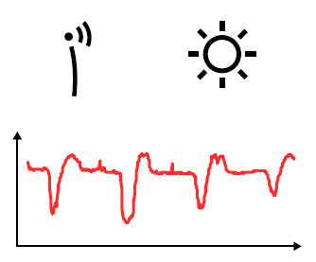
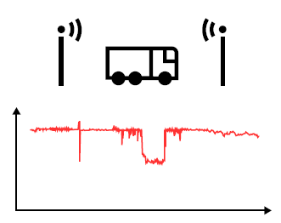
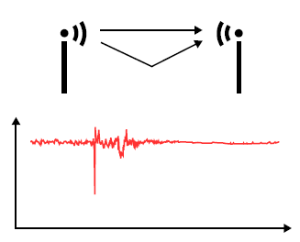
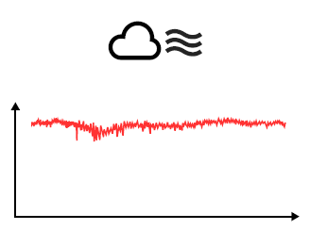
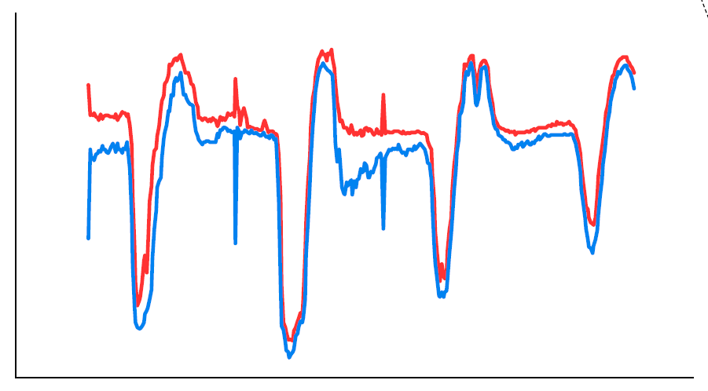

A bit of AI sprinkle…
  Enabling AI / ML to identify special patterns in collected data
  Correlate external data (e.g. weather information) for accurate forecasts and predictions
Automated root cause analysis
Early warnings of hardware degradation and high temperatures
  Network traffic forecasting and prediction
  Predict what will happen next by looking at network trends and simulating future network upgrades

Slide 18



  Worldwide brand name recognition
  > 52 networks
  18,000 hubs
  500,000 CPE
  > 50 networks
  140,000 MW
  35,000 mmw
  Accumulated expertise & know how for 30 years

Slide 19


